Slide 1
Red Hat OpenShift Recap

Slide 2
Objectives
After watching this video, you will be able to:
• Explain what Red Hat OpenShift is
• Describe the relationship between OpenShift and
Kubernetes
• Identify the services provided by OpenShift to
facilitate operations and development tasks

Slide 3
What is Red Hat OpenShift?
• Hybrid cloud: can be run on premises or in public
and private clouds
• Kubernetes: an underlying technology
• Application platform: provides additional tooling
for applications

Slide 4
OpenShift and Microservices
• OpenShift is a premiere platform for running
microservices
• Orchestrates containerized workloads
• Microservices on OpenShift can easily integrate
with serverless technologies

Slide 5
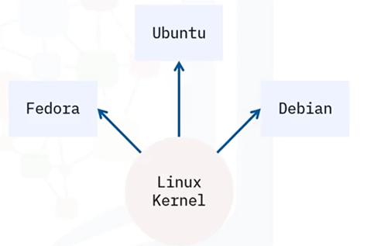
Kubernetes/OpenShift
• Linux kernel is a
powerful, open-source
operating system
kernel
• Distributions add
features and functions
to the kernel

Slide 6

Kubernetes/OpenShift analogy
• Kubernetes has core
capabilities, similar
to the Linux kernel
• Distributions built on
top of OpenShift is
like a Linux
distribution

Slide 7
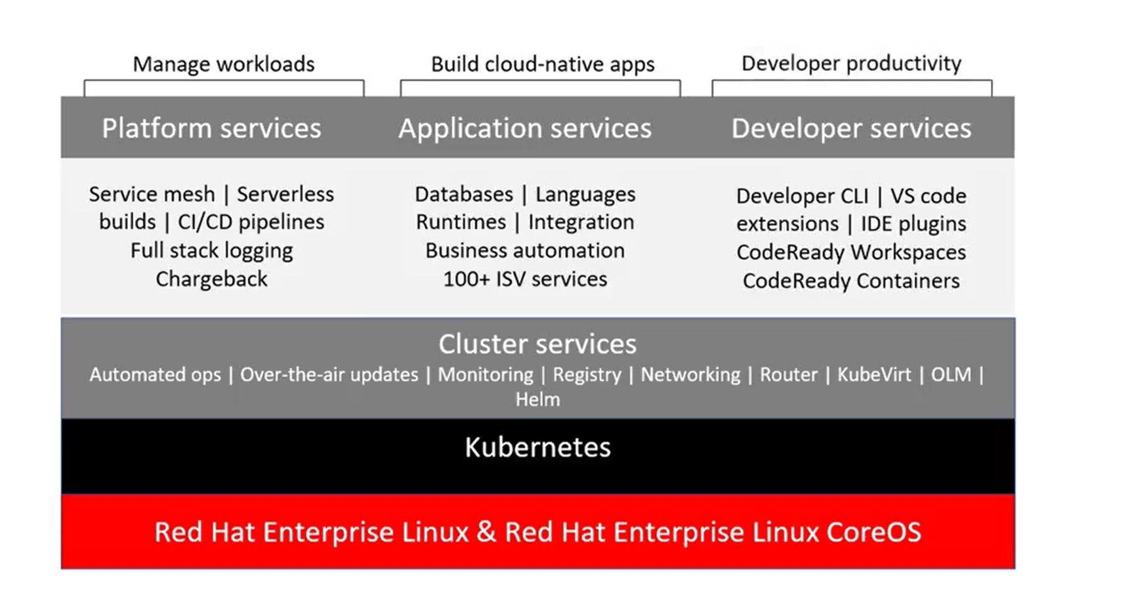

Slide 8
Summary
In this video, you learned that:
• Red Hat OpenShift is a platform for running
containerized workloads like microservices
•O enShift is like a Kubernetes distribution, in
t at OpenShift builds additional capabilities
on top of Kubernetes
• OpenShift provides a variety of services to
manage workloads, build cloud-native apps, and
increase developer productivity

